Slide 1
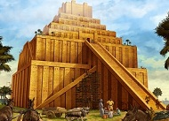
TOWER OF BABEL AND THE HISTORY OF THE WORLD

Slide 2
The Western world have many errors of their current Tower of Babel pictures.
Gen 11:2 As people moved together as one Tribe Eastward,
They found a plain called Sina and Settled there.
This clearly shows that this place is China, as East is mentioned and we all use
Sina to call China, that is where the word China comes from.
Originally the land in the East is called Sina but the S is difficult to say so over time
It was slowly changed to a C sounding word called Cina and eventually became China.
Many races in SE Asia till today still calls the Chinese Cina or Sino from the original
Word Sina which slowly changed to Cina and then to China.
Sino comes from our fore father Shem, his Jewish decedents are called Shinites and the Chinese decedents are called Sinites.

Slide 3
Other types of Babel building assumed by the West are the Ziggurat or the Pyramids.
Clearly, these buildings are not towers. No matter how hard archeologist try to force out a story,
It will definitely be wrong if they are searching in the wrong direction and culture.
Since the Tower was built in the East.
We should look for an Eastern type Tower and not a Western one.
Therefore the Biblical Tower of Babel is the Pagoda which is the only tall building in the
Ancient world anyway.
Notice that the word Tower also sound the same in Chinese, remember everyone used to speak in one Tongue. So possibly some words still remain.
Chinese only have one syllable words, and we call Ta for Tower.
If we ignore the spelling for Tower but just focus on the sound, you notice that Tower and Ta sounds exactly the same.

Slide 4
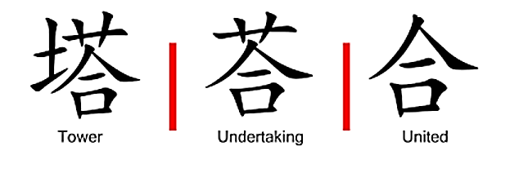
Hidden Chinese Character Secrets

Slide 5
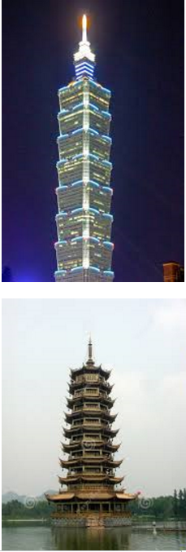
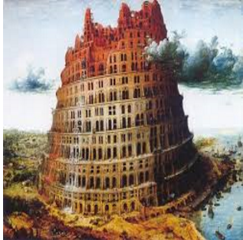

Slide 6
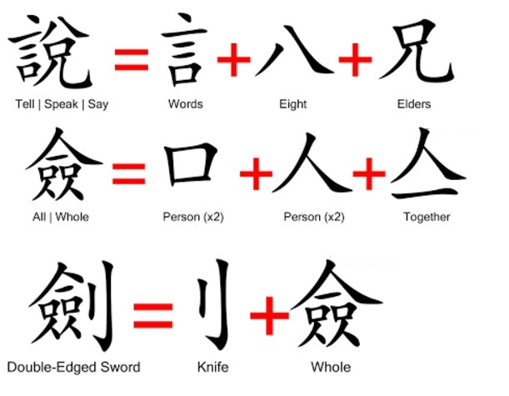
Hidden Chinese Character Secrets

Slide 7
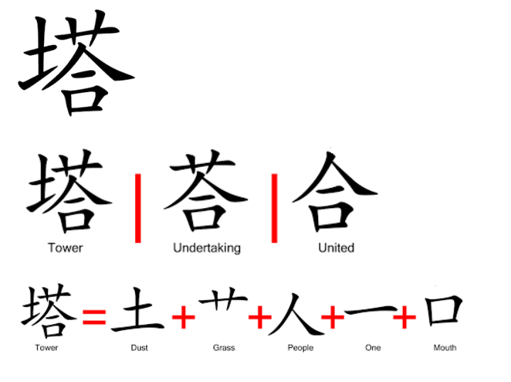
Hidden Chinese Character Secrets

